Slide 1



Supply chain project
View in Power BI
Last data refresh:
5/6/2023 11:33:40 AM UTC
Downloaded at:
5/6/2023 11:38:24 AM UTC

Slide 2
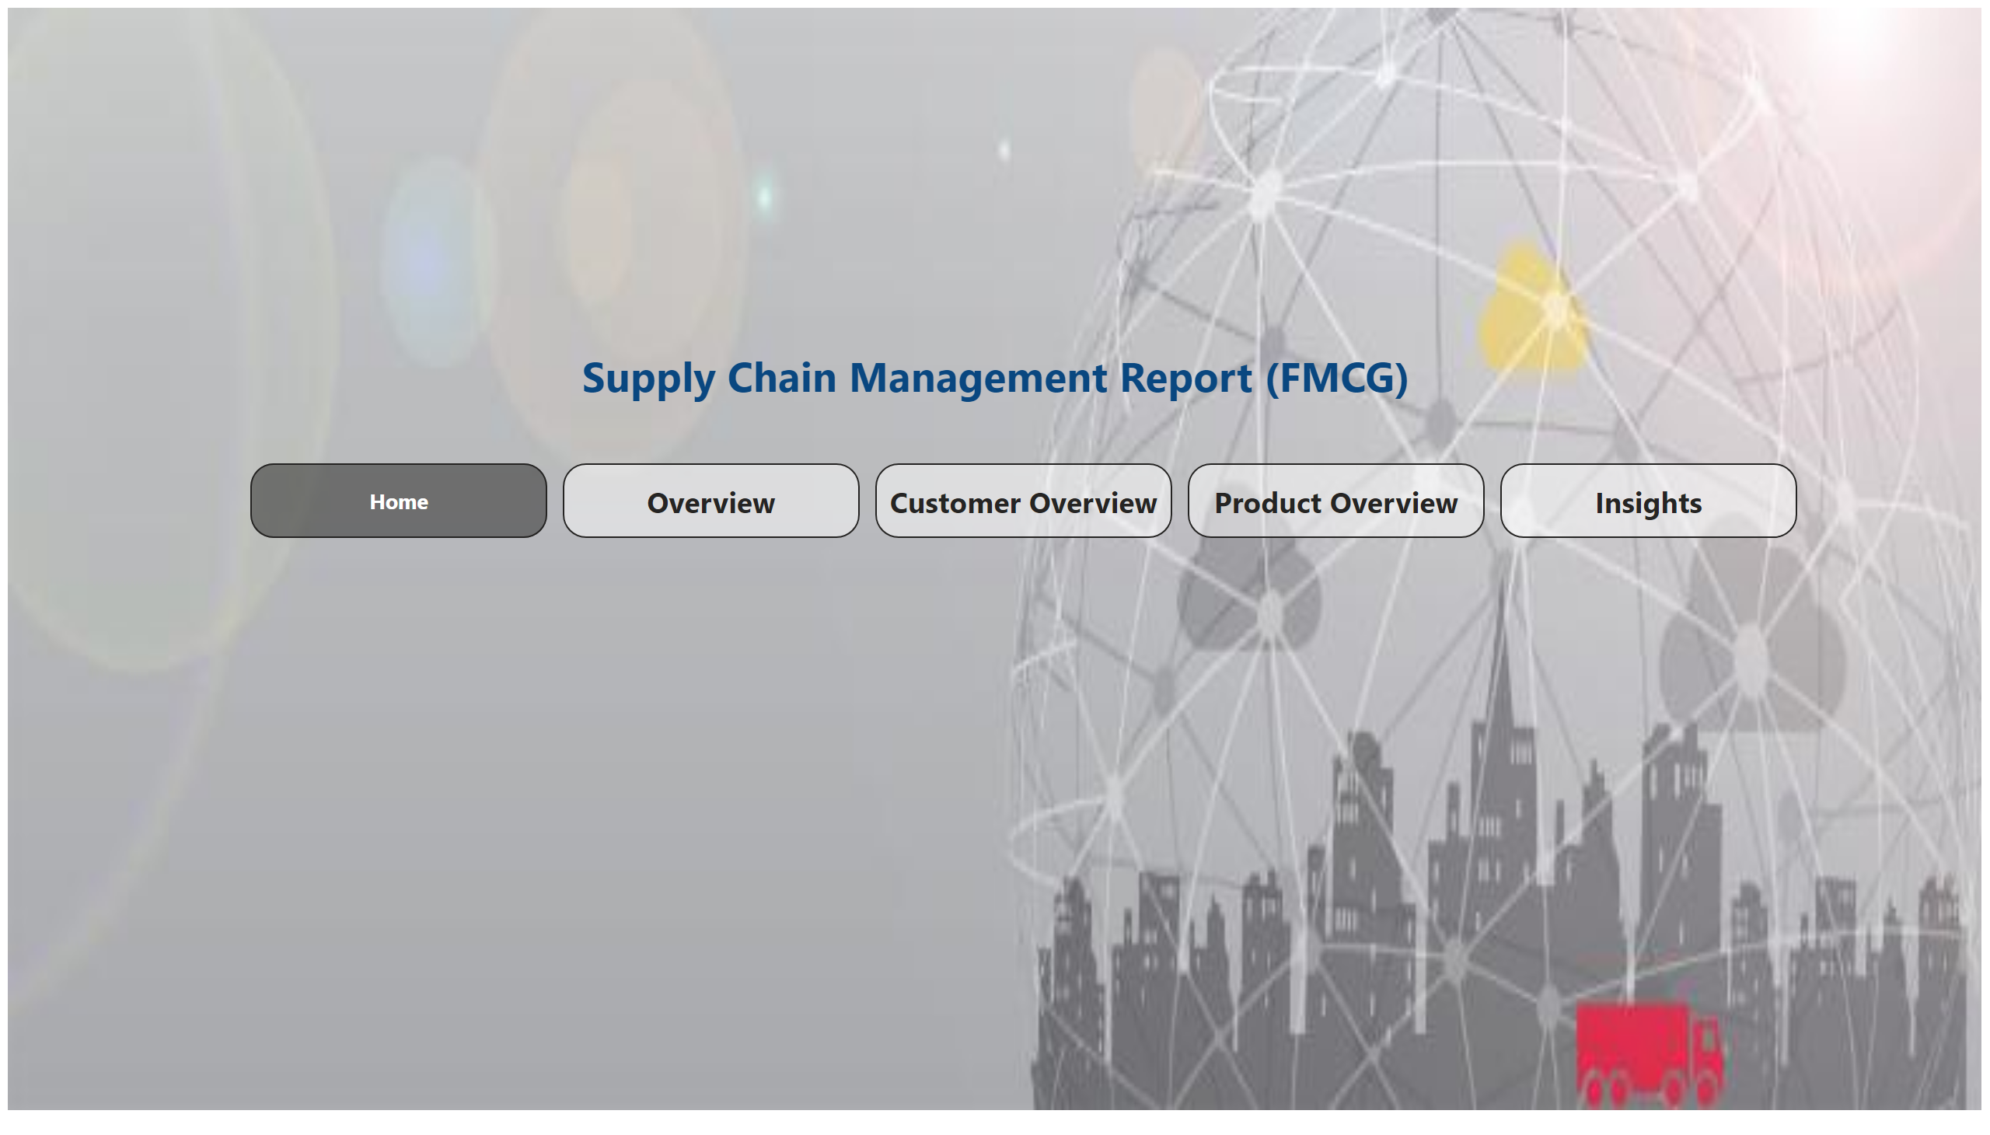
Home
Notes:
pageNavigator
No alt text provided
textbox
No alt text provided
image
No alt text provided

Slide 3
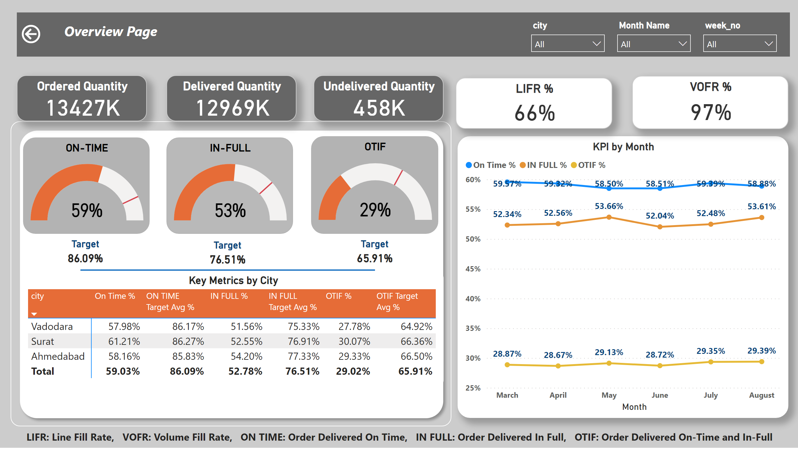
Overview
Notes:
Ordered Quantity
No alt text provided
Delivered Quantity
No alt text provided
Undelivered Quantity
No alt text provided
LIFR %
No alt text provided
VOFR %
No alt text provided
KPI by Month
No alt text provided
textbox
No alt text provided
ON-TIME
No alt text provided
IN-FULL
No alt text provided
OTIF
No alt text provided
Key Metrics by City
No alt text provided
slicer
No alt text provided
slicer
No alt text provided
slicer
No alt text provided
shape
No alt text provided
textbox
No alt text provided
actionButton
No alt text provided
shape
No alt text provided
Target
No alt text provided
Target
No alt text provided
Target
No alt text provided
shape
No alt text provided

Slide 4
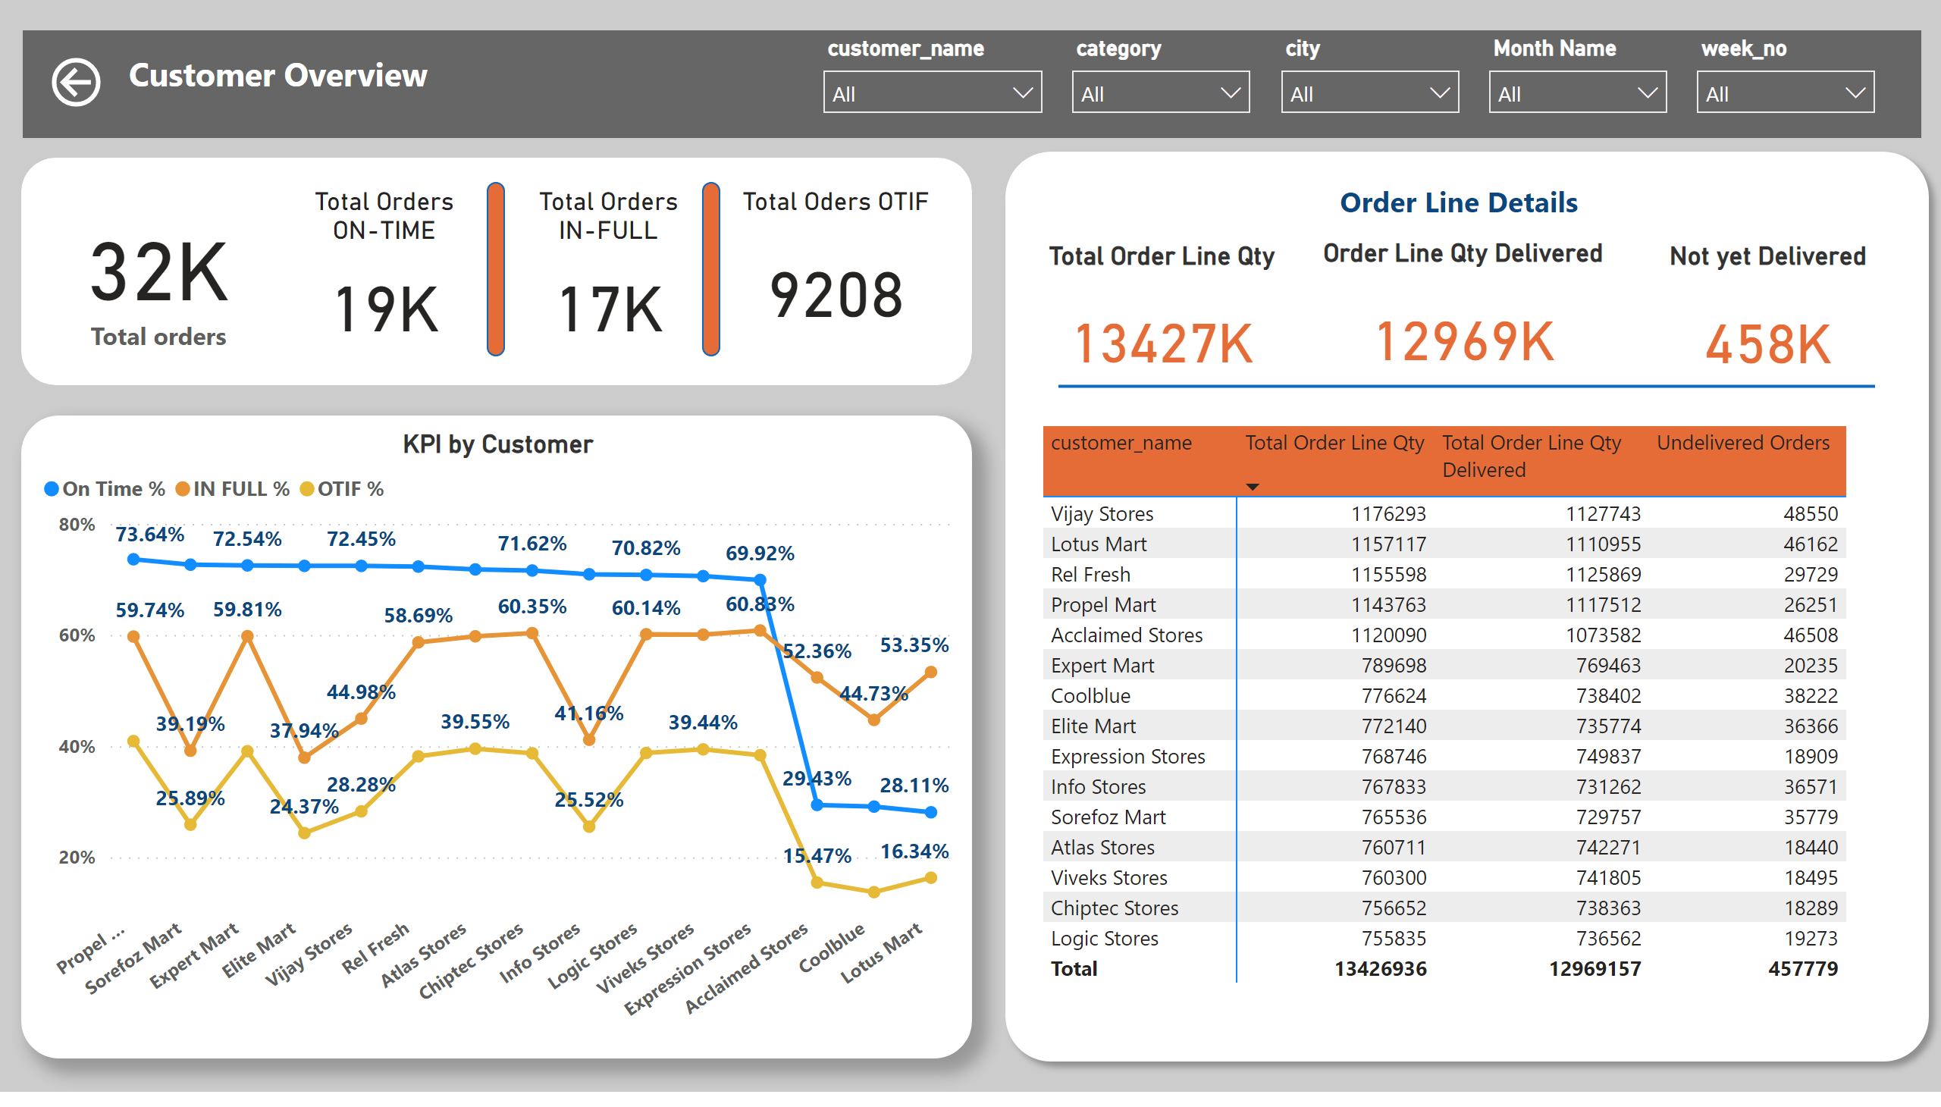
Customer Overview
Notes:
slicer
No alt text provided
slicer
No alt text provided
slicer
No alt text provided
slicer
No alt text provided
slicer
No alt text provided
Not yet Delivered
No alt text provided
Order Line Qty Delivered
No alt text provided
Total Order Line Qty
No alt text provided
shape
No alt text provided
KPI by Customer
No alt text provided
Order details by Customer
No alt text provided
actionButton
No alt text provided
shape
No alt text provided
shape
No alt text provided
shape
No alt text provided
card
No alt text provided
Total Orders ON-TIME
No alt text provided
Total Orders IN-FULL
No alt text provided
Total Oders OTIF
No alt text provided
shape
No alt text provided
shape
No alt text provided
shape
No alt text provided
textbox
No alt text provided

Slide 5
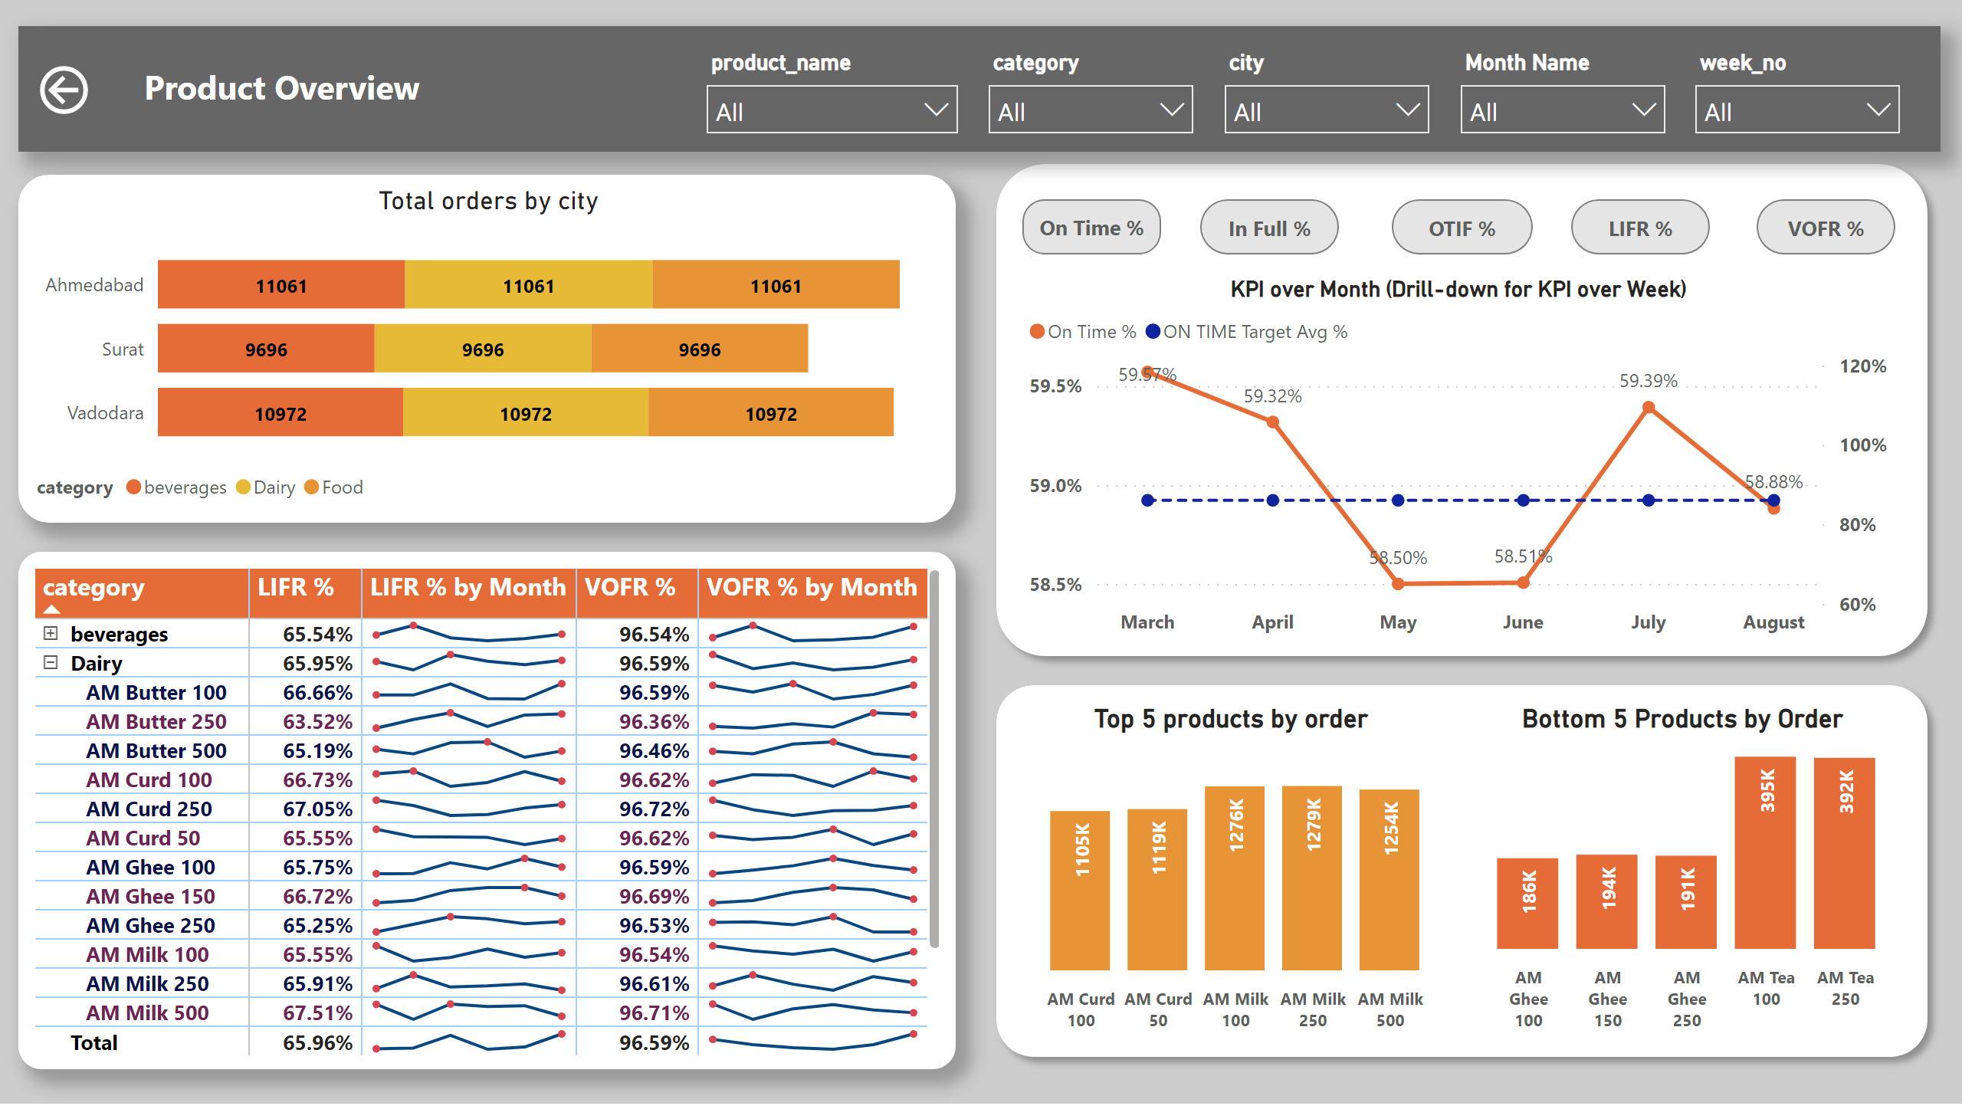
Product Overview
Notes:
actionButton
No alt text provided
actionButton
No alt text provided
actionButton
No alt text provided
actionButton
No alt text provided
actionButton
No alt text provided
lineChart
No alt text provided
KPI over Month (Drill-down for KPI over Week)
No alt text provided
lineChart
No alt text provided
lineChart
No alt text provided
lineChart
No alt text provided
slicer
No alt text provided
slicer
No alt text provided
slicer
No alt text provided
slicer
No alt text provided
slicer
No alt text provided
textbox
No alt text provided
shape
No alt text provided
pivotTable
No alt text provided
Top 5 products by order
No alt text provided
Bottom 5 Products by Order
No alt text provided
actionButton
No alt text provided
shape
No alt text provided
shape
No alt text provided
Total orders by city
No alt text provided

Slide 6
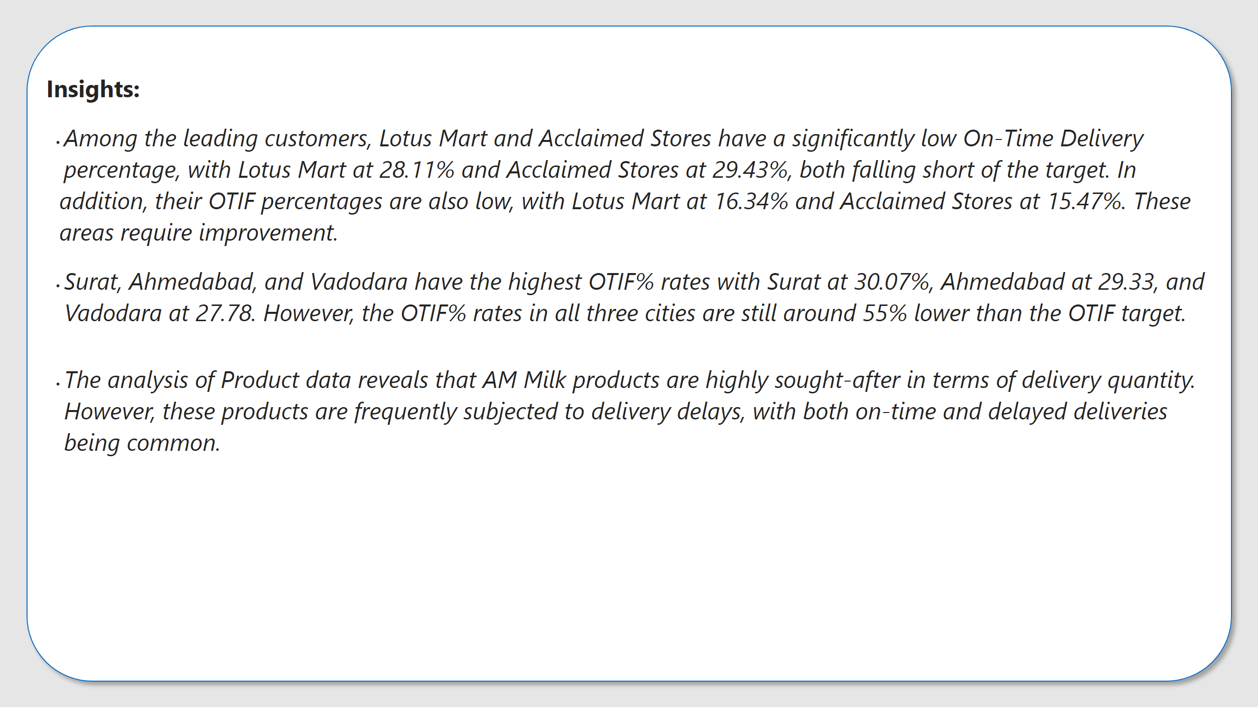
Insights
Notes:
textbox
No alt text provided
shape
No alt text provided

